Slide 1
Graph Coloring
Presented by:
1805018 - MD Rownak Sahanawaz
1805043 - Arup Debnath
1805044 - Md Misbahul Hasan Jinan
1805059 - Md Mehedi AL Masud
1805065 - Md Sayeed Hasan Ovi

Slide 2
Graph Coloring problem
The graph coloring problem involves assigning colors to the vertices of a graph in a way that no two adjacent vertices share the same color. Its applications range from scheduling and resource allocation to optimizing network and map design.
It’s a NP-hard problem. Despite its NP-hard nature, various algorithms aim to efficiently minimize the number of colors needed.

Slide 3
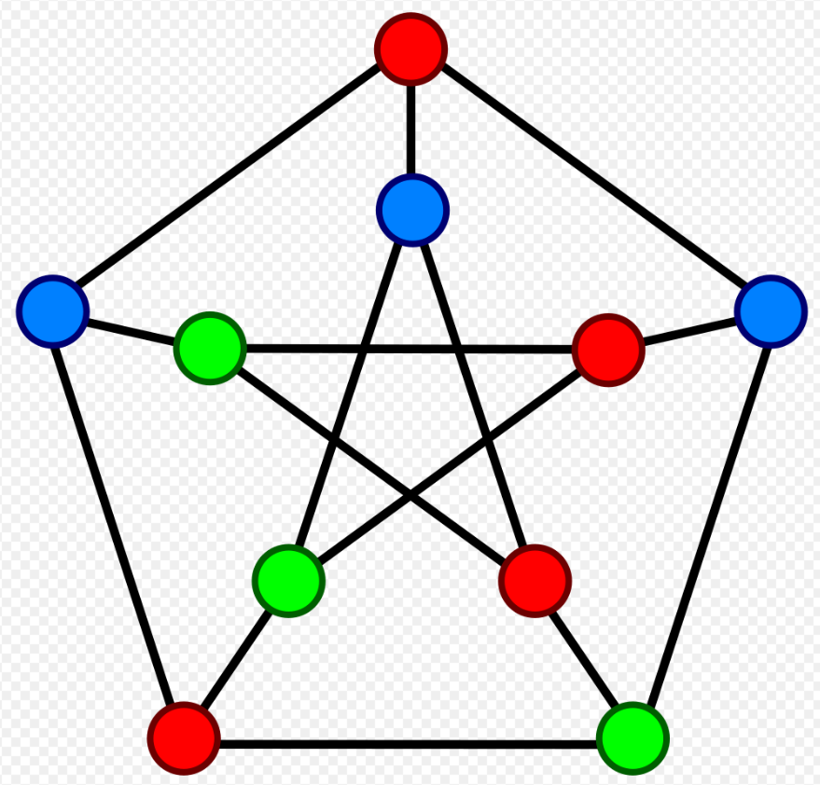
Some Terminologies
Chromatic number
Smallest number of colors required to color a graph
For cycles
Even nodes - 2
Odd nodes - 3
For tree
2 colours are required
Same colour in alternating levels

Slide 4
Proof: 3-coloring is NP-Complete
NP
We have a graph G(V,E)
We have a coloring for each node (certificate)
Process
For each edge (i,j)
We check if Color_i == Color_j
This check can be performed in polynomial time
Hence 3-coloring is in NP

Slide 5
Proof: 3-coloring is NP-Complete
NP-Hard
We have to show that
3-coloring is reducible from a proved NP-hard problem
We’ll use 3-SAT

Slide 6
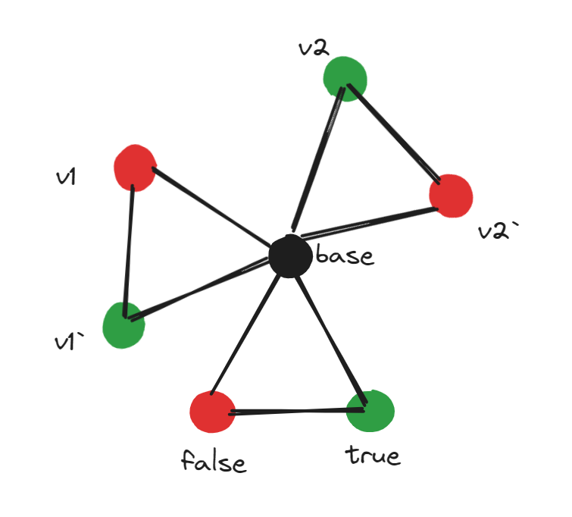
3SAT to 3-coloring
Graph construction from 3SAT
Part 1 - for the literals
2 vertices for each literal (v and -v)
3 vertices for True, False and Base
These 3 will represent 3 colors
This graph will be 3 colorable if and only if for the valid assignment of the literals

Slide 7
3SAT to 3-coloring
Graph construction from 3SAT
Part 2 - for the clauses
For each clause (containing 3 literals and 2 OR-operator)
We’ll construct this graph
This graph will be 3 colorable if and only if for the the clause returns True

Slide 8
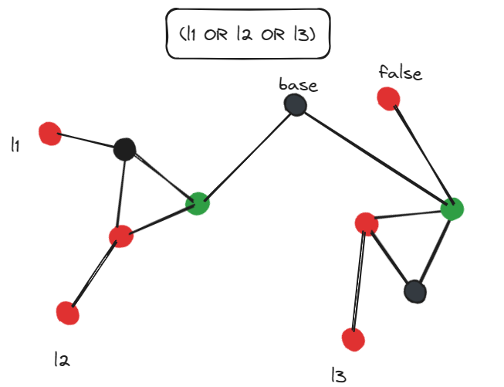

Slide 9
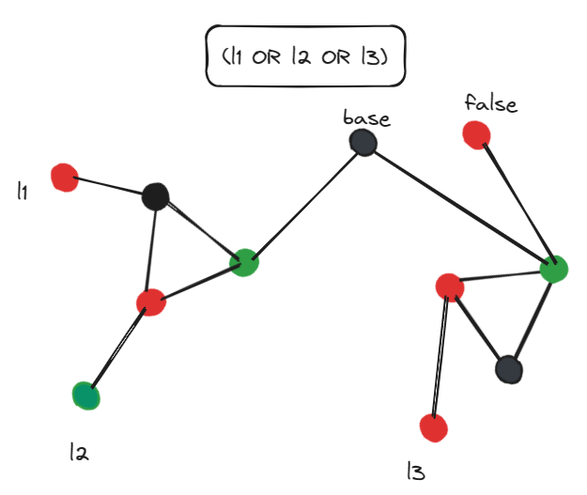
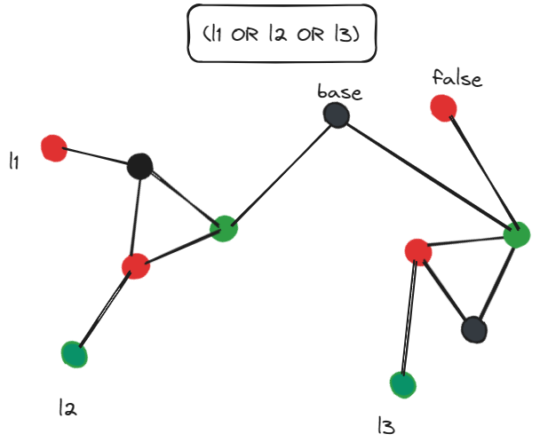

Slide 10
3SAT to 3-coloring

Slide 11
3SAT to 3-coloring
The entire previous Graph will be 3 colorable
If and only if the 3SAT formula returns True
Hence we have reduced 3SAT to graph coloring
So Graph colouring is in NP, and NP-hard, hence NP-complete.

Slide 12
Reduction from Maximum Independent Set (MIS) to Graph Coloring
Maximum Independent set Problem :
Given an undirected graph G=(V,E)
Find the largest subset of vertices V′ such that no two vertices in V′ are adjacent.

Slide 13
Reduction from Maximum Independent Set (MIS) to Graph Coloring
Create the complement graph G′(V,E') as follows:
G′ has the same vertices as G but includes an edge between any two vertices in G′ that are not adjacent in G, and vice versa.
So,
Any independent set in graph G becomes a clique (a complete subgraph) in graph G′.

Slide 14
Reduction from Maximum Independent Set (MIS) to Graph Coloring
Now ,Finding the maximum independent set in G corresponds to finding the largest clique in G′.
Coloring the vertices of G′ equates to assigning colors to the vertices such that no two adjacent vertices (clique in G′) share the same color.
MIS ≤_{P} Graph Coloring

Slide 15
Reduction from Graph Coloring to Maximum Independent Set (MIS)
Given an instance of the Graph Coloring problem with graph G=(V,E)
Create a new graph G′ as follows:
Each vertex v∈V in graph G corresponds to a clique (fully connected subgraph) in G′.

Slide 16
Reduction from Graph Coloring to Maximum Independent Set (MIS)
In graph G, finding a proper vertex coloring translates to assigning colors to vertices such that adjacent vertices have different colors.
This corresponds to finding an independent set in graph G′, where the goal is to find the largest subset of non-adjacent vertices.
Graph Coloring ≤_{P} MIS

Slide 17
Exact exponential algorithms for graph coloring
Approximation algorithms for graph coloring
Arup Debnath
1805043

Slide 18
Exact exponential algorithms for graph coloring
Bron–Kerbosch algorithm:
While primarily used for finding all maximal cliques in an undirected graph, it can be adapted to solve the graph coloring problem as well. It explores all possible color assignments to vertices and checks if they satisfy the coloring constraints.
Exhaustive Search:
This method involves checking all possible combinations of color assignments to vertices. Though it guarantees finding the optimal solution, it becomes computationally infeasible for large graphs due to its exponential time complexity.

Slide 19
Exact exponential algorithms for graph coloring
3. Backtracking Algorithms:
Algorithms like Recursive Largest First (RLF) or recursive backtracking use a heuristic to select vertices for coloring and employ backtracking to explore the solution space efficiently. It explores all possible color assignments for vertices, backtracks when a conflict occurs.
4. Exact algorithms based on dynamic programming:
Some dynamic programming approaches exist to solve the graph coloring problem, particularly for special classes of graphs or certain constraints.

Slide 20
Exact exponential algorithms for graph coloring
5. SAT/SMT-based Approaches:
Transforming the graph coloring problem into a Boolean satisfiability (SAT) or satisfiability modulo theories (SMT) problem allows the use of efficient solvers to find exact solutions for smaller graphs.

Slide 21
Approximation algorithms for graph coloring
Approximation algorithms for graph coloring aim to provide a feasible solution with a reasonable computational cost, even if it's not necessarily the optimal solution.
Here are some of the approximation algorithms:
Greedy Coloring Algorithm:
This is a simple and commonly used approach where vertices are iterated through in a specific order, and each vertex is assigned the smallest available color that doesn't conflict with its neighbors.

Slide 22
Approximation algorithms for graph coloring
2. Sequential Coloring:
This method orders the vertices and colors them one by one, trying to minimize the number of colors used.
3. Largest Degree First (LDF) Algorithm:
This algorithm selects vertices in decreasing order of their degrees and assigns the smallest available color to each vertex. It often performs better than the basic greedy algorithm in practice but still may not produce an optimal solution

Slide 23
Approximation algorithms for graph coloring
4. DSatur Algorithm:
DSatur (Degree of Saturation) is a more sophisticated greedy algorithm. It selects the vertex with the highest saturation degree (number of different colors among its neighbors) and breaks ties based on the vertex degree. This algorithm tends to produce better results compared to other greedy approaches.

Slide 24
Approximation algorithms for graph coloring
5. LP-Based Approaches:
Linear programming-based approximation algorithms formulate the graph coloring problem as an integer linear programming (ILP) problem. Techniques like LP rounding or Semidefinite Programming (SDP) rounding are used to round fractional solutions obtained from the linear programming relaxation to integer solutions, providing approximations to the graph coloring problem.

Slide 25
Randomized Algorithm for Graph Coloring
There are several randomized algorithm for graph coloring that are used in different scenarios. Some of them are:
Rivest's Algorithm (1981):
Introduced by Ronald L. Rivest, this algorithm is a randomized algorithm for graph coloring. The algorithm uses randomization to achieve an expected linear-time complexity for proper graph coloring.
Luby's Algorithm (1985):
Developed by Michael Luby, this algorithm is based on a technique called "coloring by stochastic domination."

Slide 26
Randomized Algorithm for Graph Coloring
Luby's algorithm uses a random process to assign colors to vertices with high probability of achieving a proper coloring.
Molloy and Reed's Algorithm (1995):
Proposed by Michael Molloy and Bruce Reed, this algorithm is based on a probabilistic method known as the "local lemma."
The algorithm aims to achieve a proper coloring with high probability in polynomial time.

Slide 27
Randomized Algorithm for Graph Coloring
Karger's Algorithm (1998):
Karger's algorithm can also be adapted for graph coloring. It uses random contractions to reduce the size of the graph, and it can be repeated to achieve a coloring with high probability.
Frieze and Molloy's Algorithm (2001):
Developed by Alan M. Frieze and Michael Molloy, this algorithm is based on a randomized approach using a branching process.The algorithm achieves an expected linear-time complexity for proper coloring.

Slide 28
Existing Heuristic and Meta-Heuristic
Algorithms for this Problem

Slide 29
Heuristic Algorithms
DSatur Algorithm
RLF Algorithm
Clique Cover
Genetic Algorithm

Slide 30
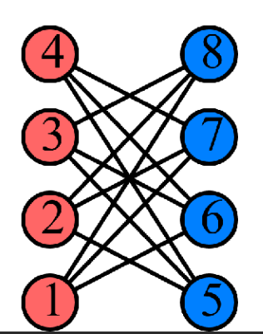
Degree of Saturation Heuristic
Coloring the vertex with the highest saturation degree.
In case of a tie, the vertex with the highest degree is chosen.

Slide 31
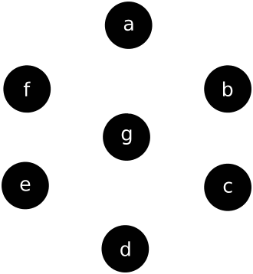
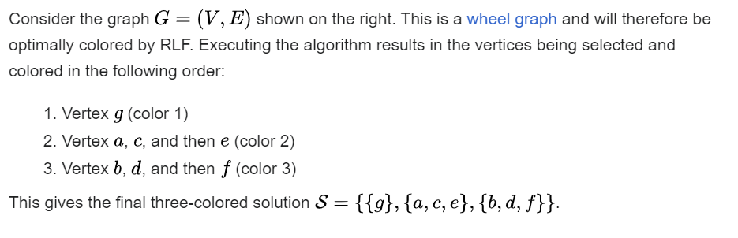
Recursive
Largest
First

Slide 32
Clique Cover
Find maximal clique.
Assign a different color to each vertex of clique.
Remove the colored vertices and continue this process until no vertex remains.

Slide 33
Meta-Heuristic Algorithms
ACO- Ant Colony Optimization
GALS- Genetic Algorithm with Local Search
PSO - Particle Swarm Optimization
VNS - Variable Neighborhood Search

Slide 34
MetaHeuristic Algorithms
Ant Colony Optimization: Using the shortest path and pheromone trails of this algorithm. Update pheromone matrix and use this guide to construct feasible coloring.
Particle Swarm Optimization

Slide 35
MetaHeuristic Algorithms
GALS: To update each individual towards driving them to local optimum. This is used in addition to selection, crossover and mutation of Genetic Algorithm.
Variable Neighborhood Search: Extension of local search

Slide 36
Theoretical Applications
Studying the properties of graph coloring algorithms contributes to theoretical advancements in graph theory and combinatorial optimization.

Slide 37
Real World Applications
Register Allocation in Compilers:
Frequency Assignment in Wireless Networks:
Timetabling and Scheduling:
Map Coloring in Geographic Information Systems (GIS): When mapping regions, the graph coloring problem arises, ensuring adjacent regions have distinct colors on a map.

